Slide 1


Status Report MVA Jet Discriminator NTUA
Giannis Papakrivopoulos
George Bakas

Slide 2
Training
Discriminator trained to identify objects (top jets) and
not events as was done previously
Datasets used: (** jetToolBox was used)
Signal:
TT_TuneCUETP8M2T4_13TeV-powheg-pythia8/RunIISummer16MiniAODv3-PUMoriond17_94X_mcRun2_asymptotic_v3-v1/MINIAODSIM
TT_Mtt-1000toInf_TuneCUETP8M2T4_13TeV-powheg-pythia8/RunIISummer16MiniAODv2-PUMoriond17_80X_mcRun2_asymptotic_2016_TrancheIV_v6-v2/MINIAODSIM **
TT_Mtt-700to1000_TuneCUETP8M2T4_13TeV-powheg-pythia8/RunIISummer16MiniAODv2-PUMoriond17_80X_mcRun2_asymptotic_2016_TrancheIV_v6-v1/MINIAODSIM **
Category training: Split the training sample in
categories. In our case the splitting is based on the jet Pt.
Bins:
[400,600] GeV
[600,800] GeV
[800,1200] GeV
[1200 –inf) GeV
Training Variables:
JetMassSub0, JetMassSub1
Tau1, Tau2, Tau3
Training contains jets:
From events with two or more jets.
From events that have no leptons.
From events where the sub-leading jet pt > 400 GeV.
That are DR matched (DR<0.4) with a top parton
Background
QCD_HT300to500_TuneCUETP8M1_13TeV-madgraphMLM-pythia8/RunIISummer16MiniAODv3-PUMoriond17_94X_mcRun2_asymptotic_v3_ext1-v2/MINIAODSIM
QCD_HT500to700_TuneCUETP8M1_13TeV-madgraphMLM-pythia8/RunIISummer16MiniAODv3-PUMoriond17_94X_mcRun2_asymptotic_v3_ext1-v2/MINIAODSIM
QCD_HT700to1000_TuneCUETP8M1_13TeV-madgraphMLM-pythia8/RunIISummer16MiniAODv3-PUMoriond17_94X_mcRun2_asymptotic_v3_ext1-v2/MINIAODSIM
QCD_HT1000to1500_TuneCUETP8M1_13TeV-madgraphMLM-pythia8/RunIISummer16MiniAODv3-PUMoriond17_94X_mcRun2_asymptotic_v3_ext1-v2/MINIAODSIM
QCD_HT1500to2000_TuneCUETP8M1_13TeV-madgraphMLM-pythia8/RunIISummer16MiniAODv3-PUMoriond17_94X_mcRun2_asymptotic_v3_ext1-v2/MINIAODSIM
QCD_HT2000toInf_TuneCUETP8M1_13TeV-madgraphMLM-pythia8/RunIISummer16MiniAODv3-PUMoriond17_94X_mcRun2_asymptotic_v3_ext1-v2/MINIAODSIM

Slide 3
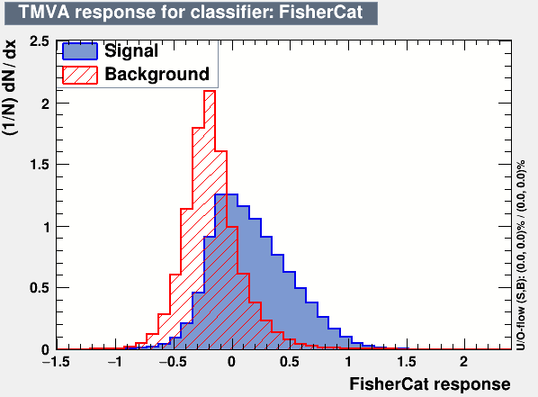
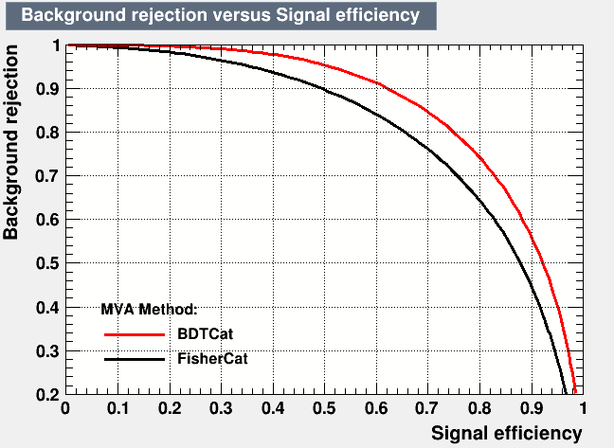
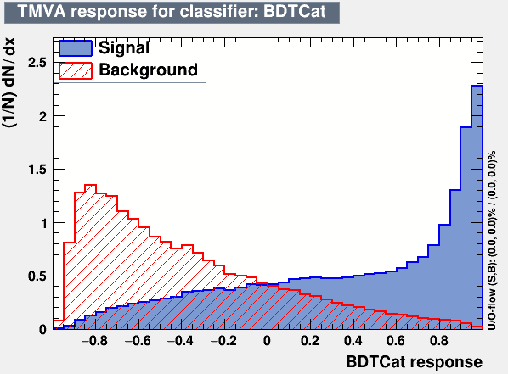
Training output

Slide 4
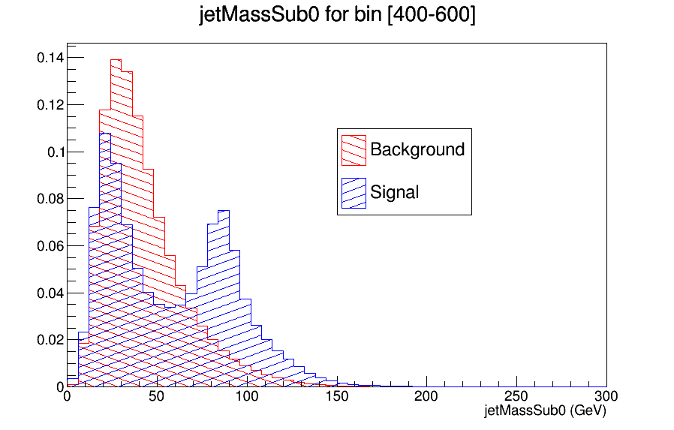
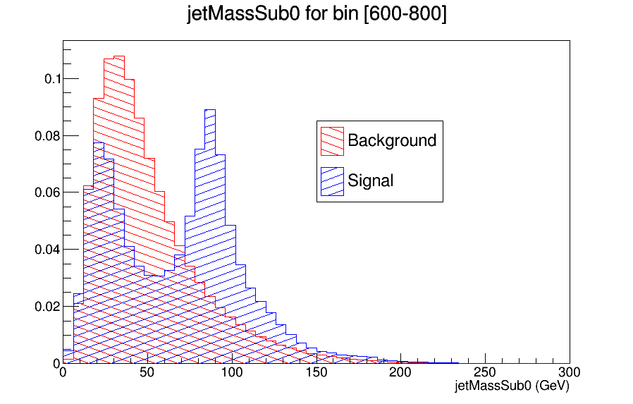
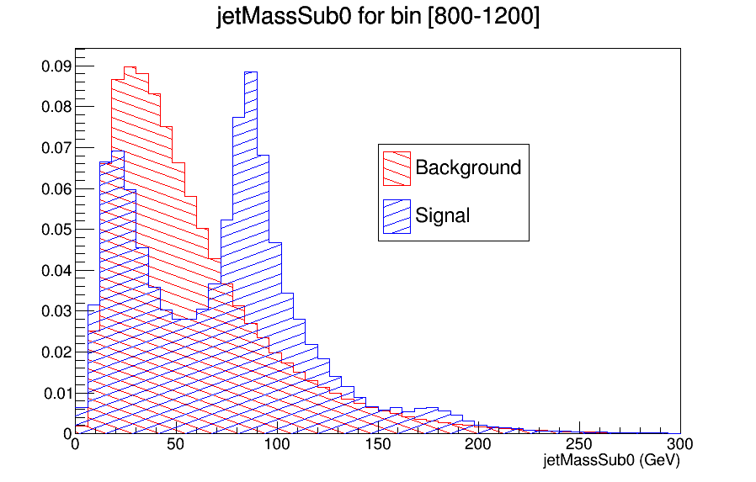
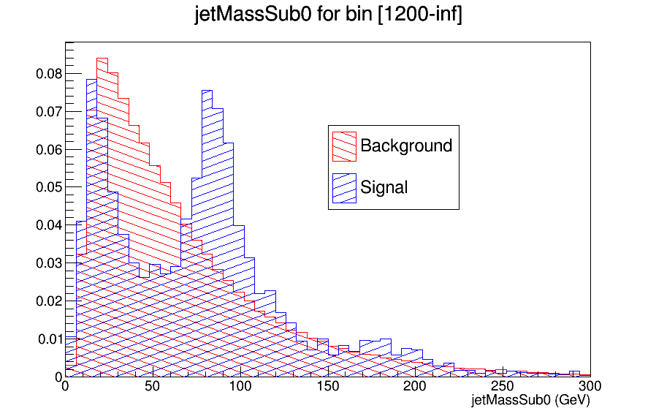
Training variable distributions
Mass of the first
subjet

Slide 5
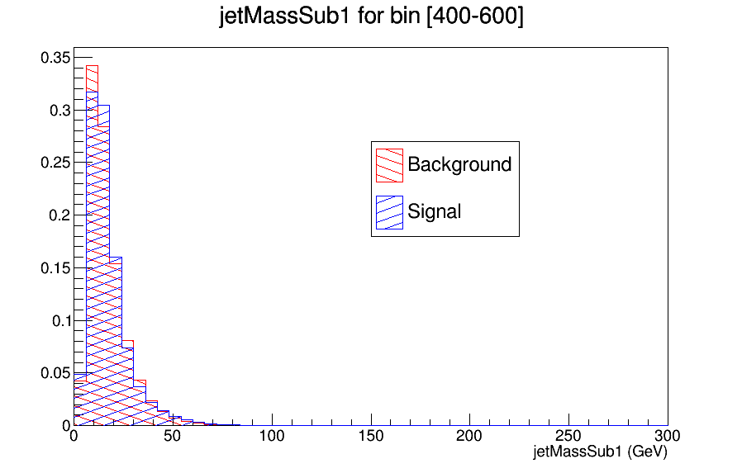
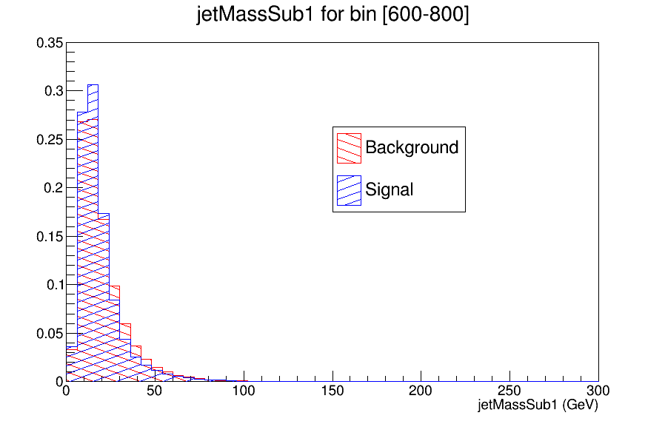
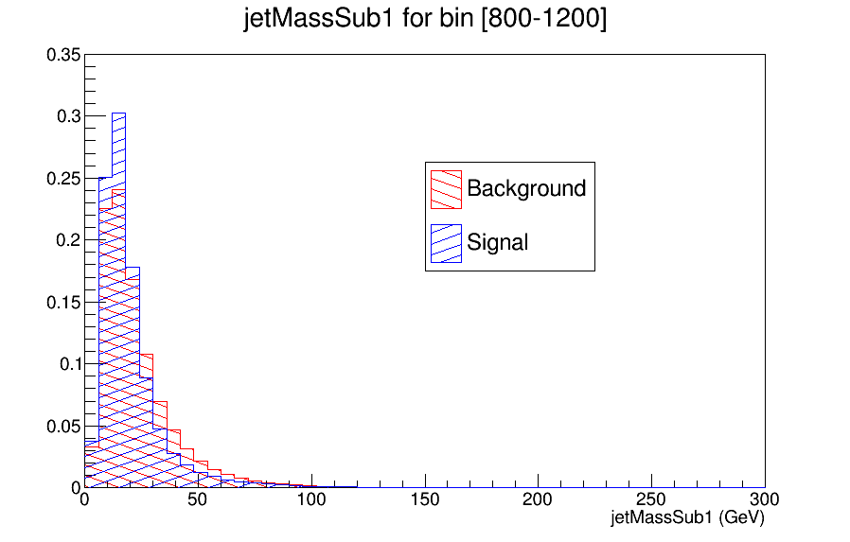
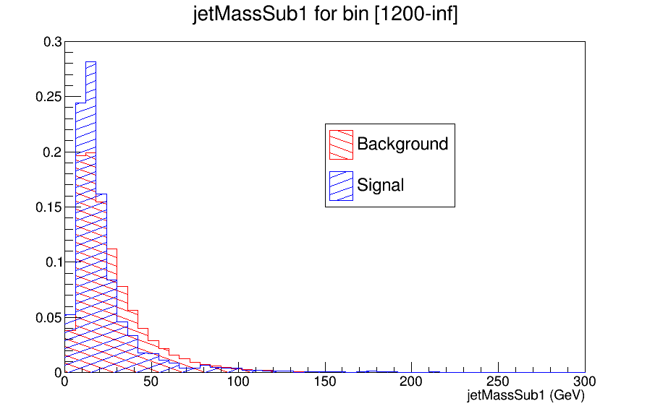
Training variable distributions
Mass of the second
subjet

Slide 6
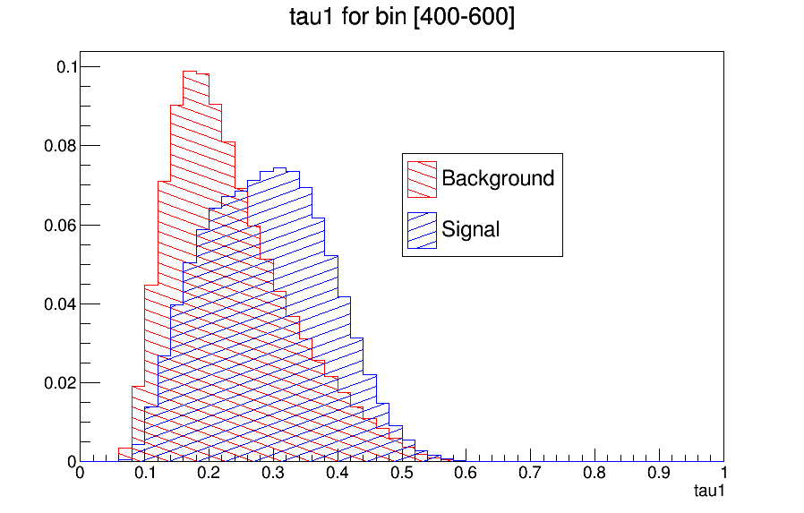
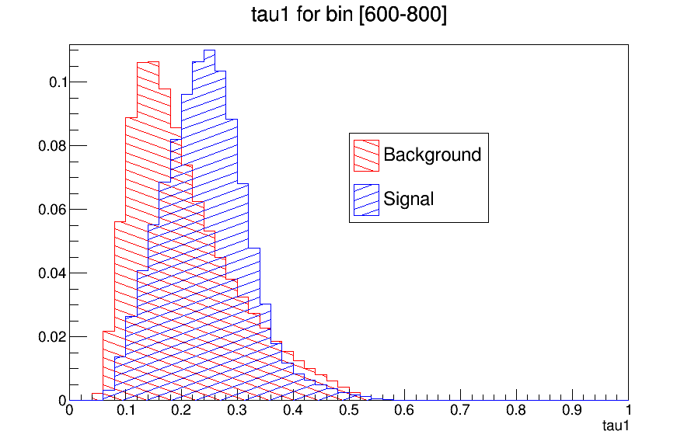
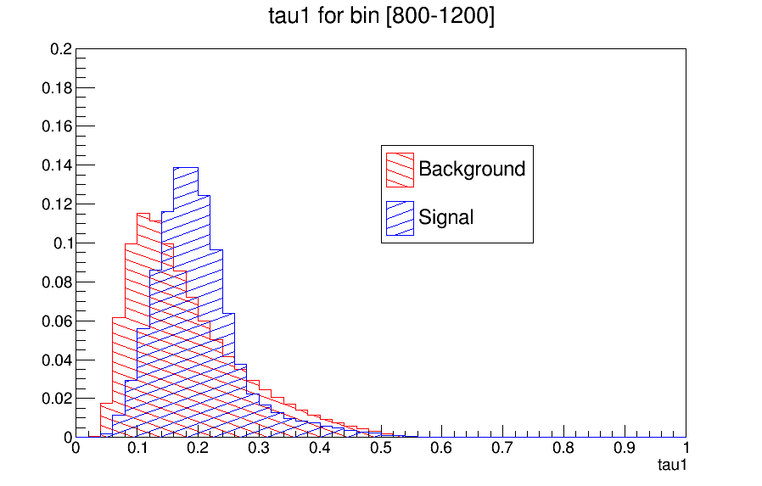
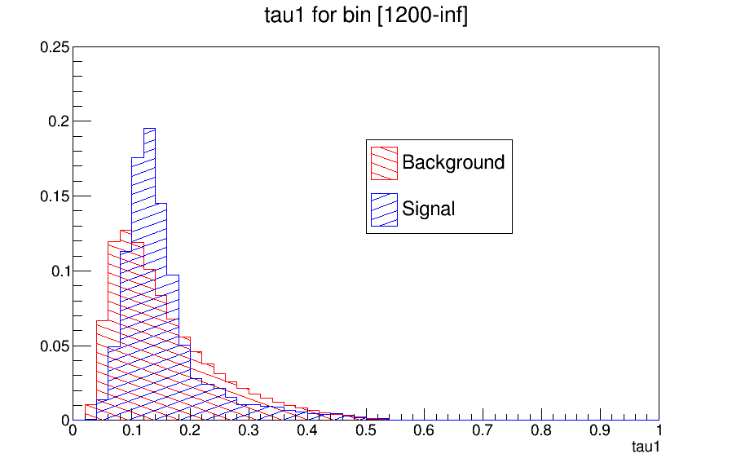
Training variable distributions
tau1

Slide 7
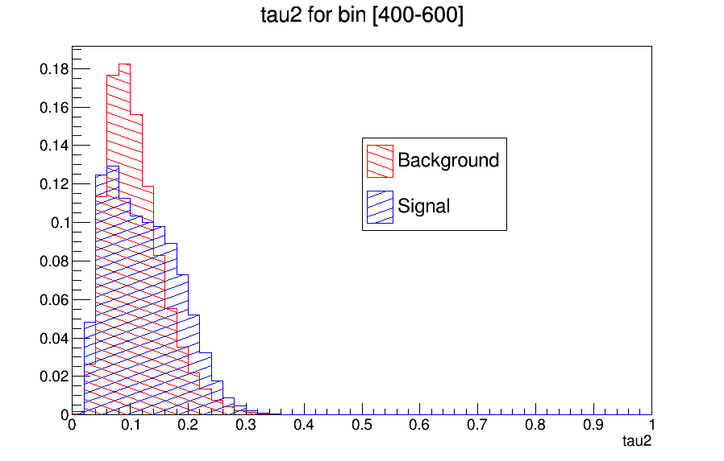
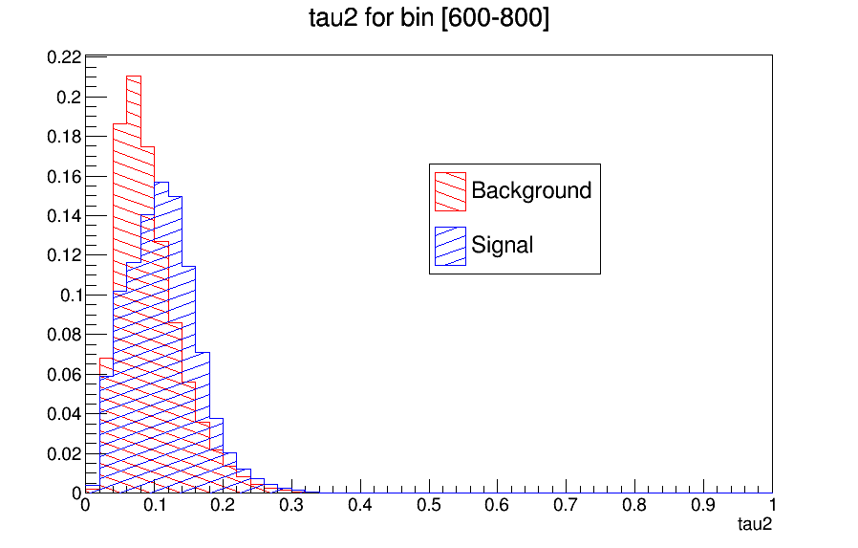
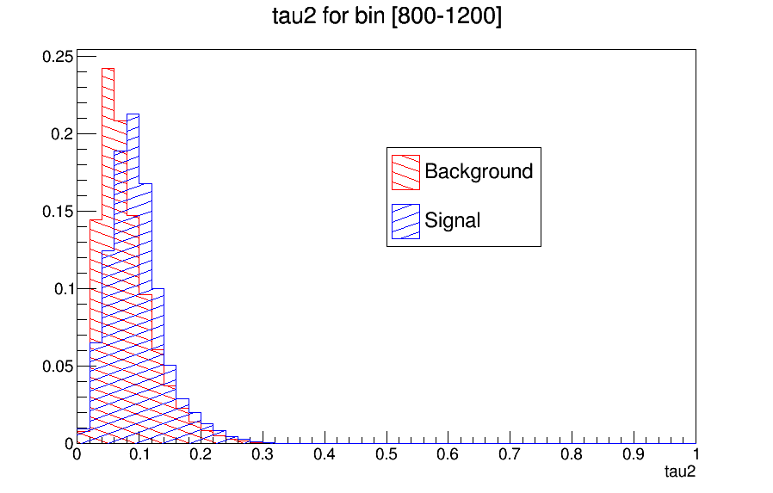
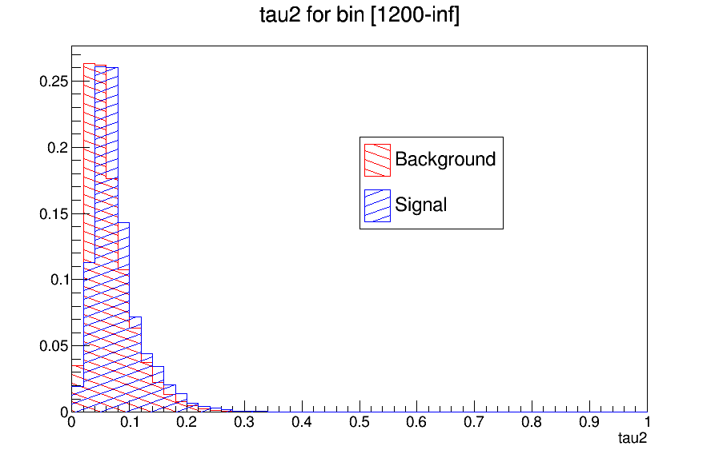
Training variable distributions
tau2

Slide 8
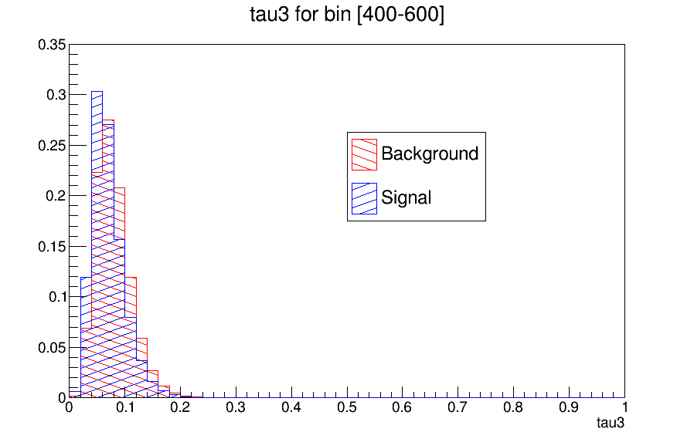
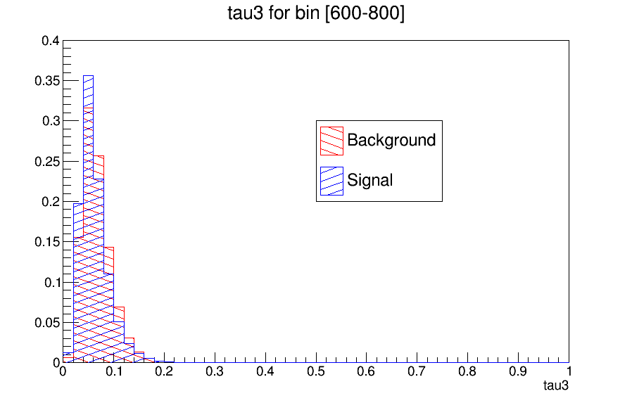
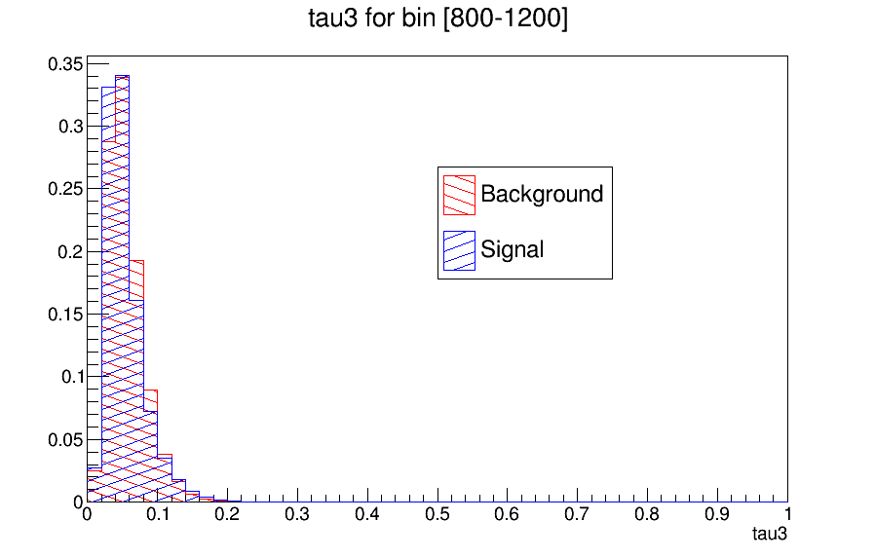
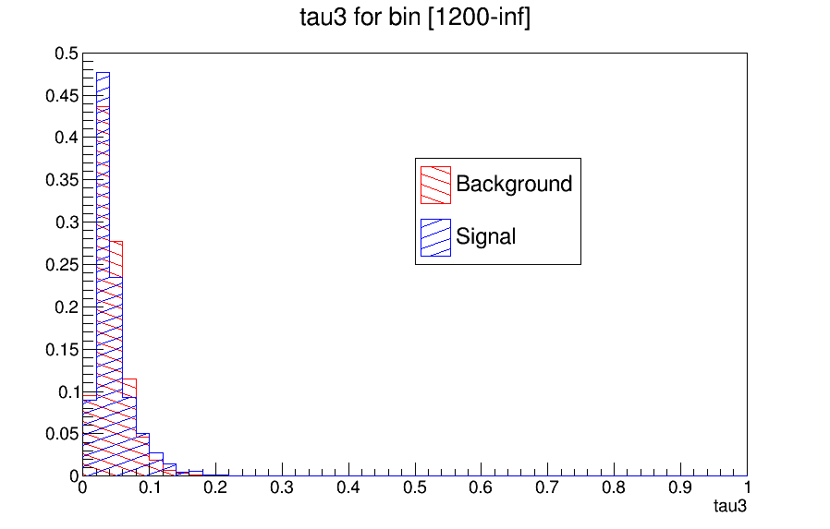
Training variable distributions
tau3

Slide 9
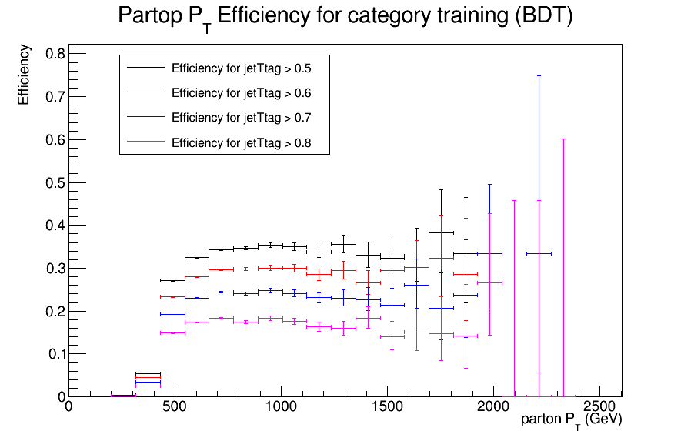
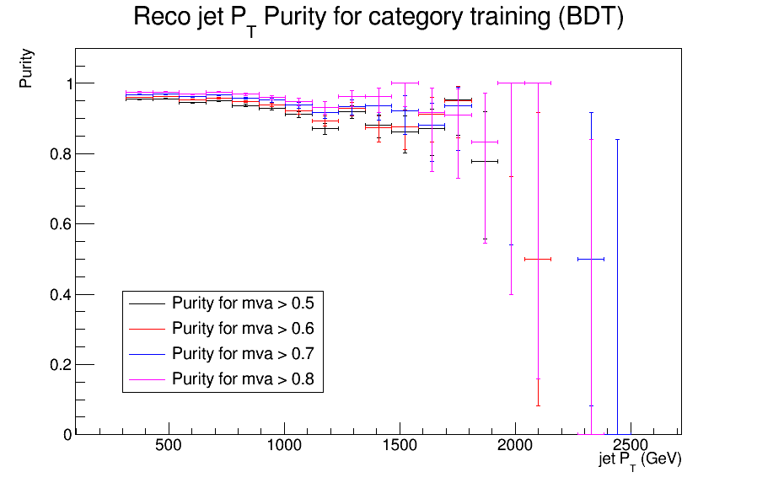

Efficiency and purity
Event selections:
|jetEta|<2.4
jetPt > 400
Efficiency (parton Pt) = $\frac{\# of partons that are matched with a selected reco jet}{all partons}$
Purity (jet Pt) = $\frac{\# of selected reco jets that are matched with a parton}{\# of seleced reco jets}$

Slide 10
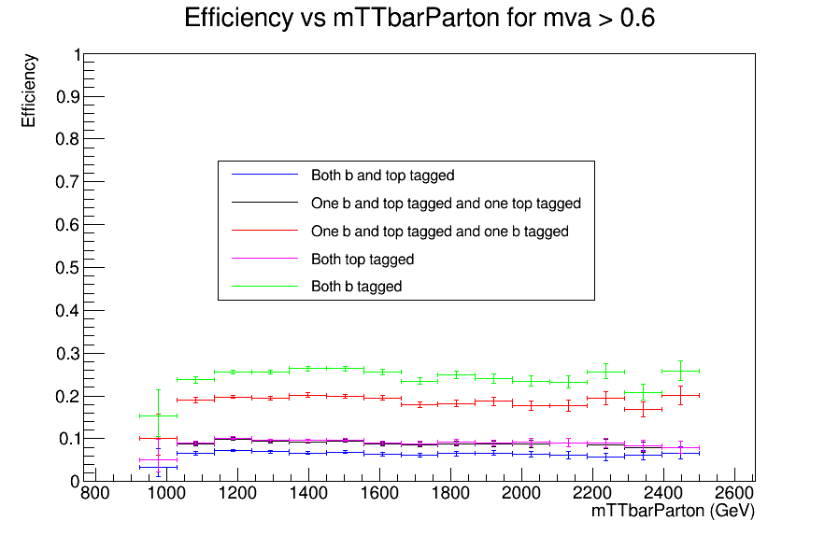

Efficiency vs mTTbarParton
Efficiency=$\frac{\# of selected events that are in one a category}{\# of selected events}$
Event selections:
nJets > 1
mTTbarParton > 1000 GeV
|parton Eta| < 2.5
partonPt > 500 (both partons)
mTTbarParton > 1000
subleading jetPt > 400
120 < jetMassSofrDrop < 220
Event categories
Both jets are b and top tagged.
One jet is b and top tagged and one is top tagged.
One jet is b and top tagged and one is b tagged.
Both jets are top tagged.
Both jets are b tagged.
For top tagging, mva > 0.6 and for b tagging, we used the loose working point from: https://twiki.cern.ch/twiki/bin/viewauth/CMS/BtagRecommendation94X

